Slide 1

Misuse of Antibiotic during Pregnancy as a Neonatal Risk towards Antimicrobial Resistance Development.
Name: Silas O. Awuor
Qualification: CMLT, DMLT, B.Sc. MLS, MSc, PhD-Medical Microbiolog
Specialty: Medical Microbiology
Institution: JOOTRH-Kisumu
September 2025

Slide 2

Background
During pregnancy, mothers are at high risk on bacterial infection such as urinary tract infection (UTI)
Frequent prescription of antibiotic are done for the management of such infection that threaten maternal and fetal health.
The burden is especially high in low- and middle-income countries (LMICs).
A Healthy Child A Healthy Country
Notes:
Despite an average daily census of approx.
60/patients/day in NBU
55/patients/day in Pediatrics

Slide 3
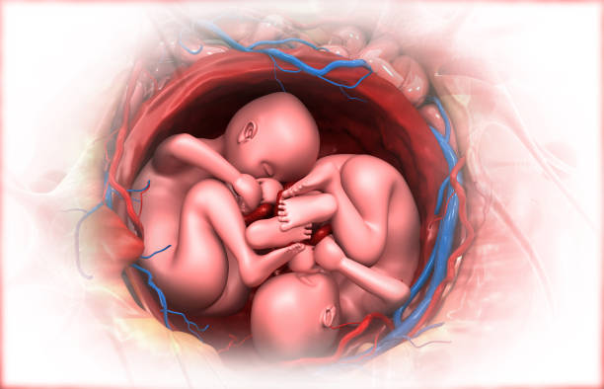
Objectives:
  This research examines the impact of maternal antibiotic use on neonatal AMR, focusing on microbiome disruption, resistance mechanisms, and clinical outcomes.

Slide 4

Study parameters
Time period:
  January 2025 and June 2025
Inclusion criteria:
  Pregnant women with history of UTI
  Newborn baby at 0 day old
Culture specimens:
  Blood and Urine
Quantitative assessment of antibiotic utilization at JOOTRH

Slide 5

Data analytics:
Mixed methods qualitative and quantitative design
Descriptive assessment of baseline characteristics and clinical infection data.
Notes:
Descriptive assessment data not available yet, analysis ongoing

Slide 6
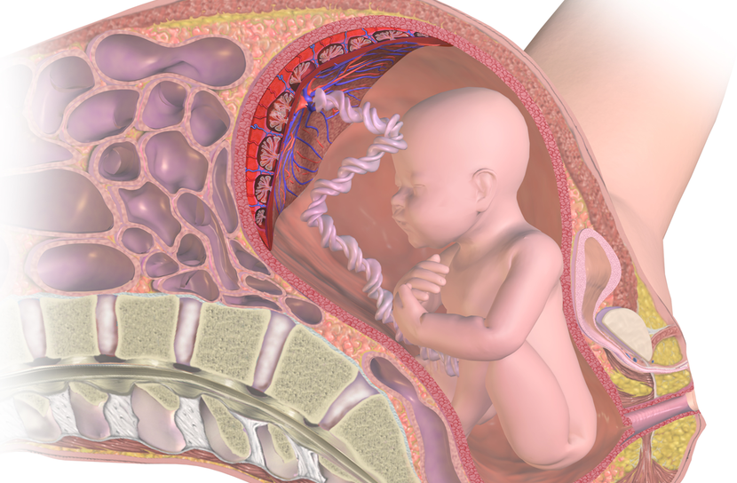
Outcome
Exposure to antibiotics in the womb, often due to overuse for viral infections or unnecessary empirical treatment, exposes the developing infant to potential resistance mechanisms and can disrupt immune system development.
Notes:
Despite an average daily census of approx.
60/patients/day in NBU
55/patients/day in Pediatrics

Slide 7
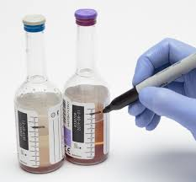
How Misuse of Antibiotics During Pregnancy Fuels AMR
Antibiotics disrupt the beneficial bacteria in the mother's and infant's gut, creating an environment where resistant bacteria can flourish and outcompete susceptible strains.
Microbiome Disruption:
Exposure to antibiotics exerts selective pressure, favoring the survival and proliferation of bacteria that possess resistance genes.
Selective Pressure:
Infants exposed to maternal antibiotics are at a higher risk of infections caused by multidrug-resistant organisms, leading to more severe disease and increased mortality.
Increased Risk for Neonates:
Notes:
this slide or next - decide which you like and delete the other :)

Slide 8
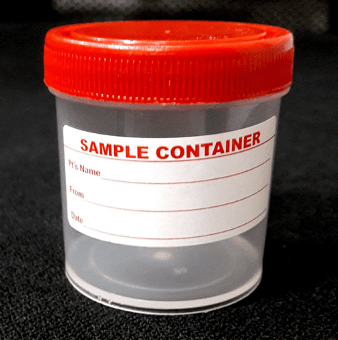
Risks for the Neonate beyond AMR
Early life exposure to antibiotics can interfere with the proper establishment and development of the infant's immune system, which is stimulated by the maternal microbiome.
Altered Immune Development:
This disruption is linked to a higher risk of allergies, asthma, autoimmune disorders, and obesity later in life.
Increased Susceptibility to Other Diseases:
Neonates with prenatal antibiotic exposure face potential lifelong complications, including gastrointestinal disorders and compromised immunity.
Long-Term Health Complications:
Notes:
Comment about:
- determination of clinical significance of CONS
specify what organisms fall under MDR

Slide 9
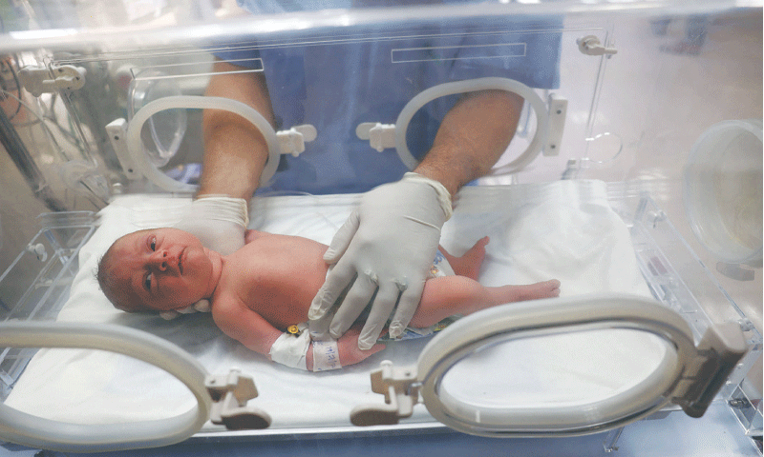
Results
Overall (n=203) were registered on this study at their last ANC visit.
The prevalence of UTI was 122 (60%).
Only 40 UTI positive mothers delivered in the facility
Table 2. Bacterial profile of Gram-negative and gram positive isolatedamong the pregnant women with UTI
Isolates | Frequency (N=40)
S. aureus | 4(10%)
CoNS | 2(5%)
Staphylococcus saprophyticus | 2(5%)
Escherichia coli | 10(25%)
Klebsiella pneumonia | 8(20%)
Proteus mirabilis | 5(12.5%)
Pseudomonas aeruginosa | 9(22.5%)

Slide 10

The prevalence of AMR was found to be 53% (95% CI: 46.1%–59.8%).
The drugs highly resistant to antimicrobials were Amikacin (88.3%), ampicillin (77.8%), and Norfloxacin (58.5%), while the least resistant drug was chloramphenicol (20%).
Same resistant pattern was also observed on the 40% isolated pathogen from the newborn.

Slide 11
conclusion
Antimicrobial Stewardship
Antimicrobial stewardship programs promote the judicious use of antibiotics, ensuring they are prescribed only when necessary and for the correct indication.
Appropriate Prescribing:
This involves using antibiotics for confirmed bacterial infections rather than empirical treatment for non-specific symptoms, and using diagnostics to guide appropriate therapy.
Targeted Use:
Stewardship in obstetrics requires careful consideration to balance the need to treat maternal infections with the potential risks of unnecessary antibiotic exposure for both mother and baby.
Balancing Benefits and Risks:

Slide 12

A deeper understanding of vertical transmission of antibiotic resistance from mothers to their offspring is necessary to determine the most effective strategies for reducing antibiotic resistance in the early life.

Slide 13


Thank you.
QUESTIONS?
Acknowledgement:

